Slide 1

NYC Healthcare Navigator
Group-5
Ansuman Patnaik
Mridul Sankarakumar
Yashwant Sai

Slide 2
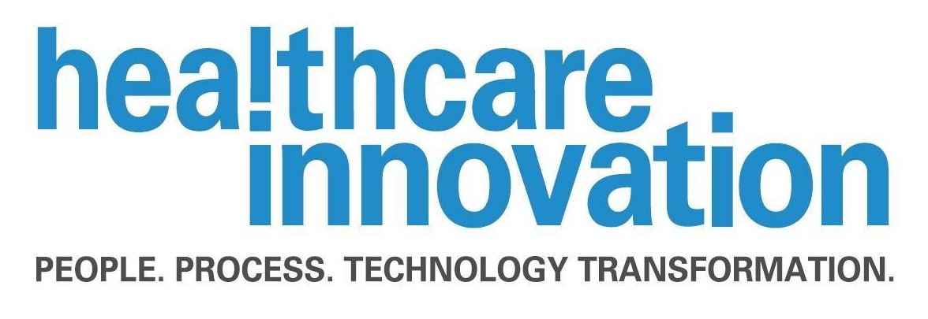

About this Project
Objective: To create a comprehensive dashboard for visualizing healthcare facilities in New York City to aid in decision-making, policy planning, and resource allocation.
Goals:
Analyse ownership structures, identifying the predominant ownership types in healthcare.
Track facility growth over time to understand trends in healthcare infrastructure.
Assess geographic distribution to identify areas with high and low concentrations of healthcare facilities.
Reveal patterns and trends that might influence healthcare policies and strategies.
Support data-driven decisions for policymakers, healthcare strategists, and stakeholders.

Slide 3

Dataset Summary
Dataset Source: New York State Department of Health
Focus: Article 28, 36, 40, and 7 healthcare facilities and programs, emphasizing hospitals and hospital extension clinics.
Dataset Characteristics:
Total Rows: 6,149 Facilities
Total Columns: 36 detailed columns including Facility ID, Facility Name, Address, and Facility Type, based on ownership types, among others.
Dataset Utility:
A crucial resource for understanding healthcare facility distribution across New York State.
Helps stakeholders gain insights into the healthcare infrastructure, supporting data-driven decision-making.
Applications:
Identifying gaps in healthcare services.
Guiding healthcare service distribution and policy development.

Slide 4

Project Sponsor
Name of the Sponsor: Olivia Mitchell
Organization of the Sponsor: Healthcare Innovation Corporation
Olivia Mitchell is working as Chief Medical Officer at Health Innovation Corporation.
Manages the 1-billion-dollar healthcare industry of New York City
Motivation of the sponsor: To help people choose the right health provider of their choice

Slide 5
3-Minute Story
Olivia Mitchell is the Chief Medical Officer at Healthcare Innovation, and she has a mission to make healthcare simple and accessible for everyone in New York State. She has a $1 billion budget to manage healthcare, but she faces a big challenge—the city's healthcare system is complicated. There are hospitals, clinics, and other facilities, all owned by different groups like not-for-profit corporations, business corporations, private companies, and individuals. This can make it really confusing for people who need to find the right healthcare quickly.
Olivia wanted a team of analysts to analyse healthcare data and help her find a solution called the NYC HealthCare Navigator. It's a dashboard that helps people find healthcare in New York State. The dashboard has a simple map showing where all the healthcare facilities are located. It also has a recommendation feature that helps users find the best places to go for their healthcare needs. People can see what services each facility offers, making it easier to choose the right one.
The NYC HealthCare Navigator isn't just for patients and families—it also helps healthcare professionals like Olivia and various policymakers as well. With this dashboard, Olivia can see where there are gaps in healthcare services and where she should focus her company's resources. It's a tool that makes the whole healthcare system easier to understand.
Now, Olivia can make better decisions. She can find the best places to open new facilities and ensure that everyone in New York City has access to the healthcare they need. The dashboard helps families find care for their loved ones, students find nearby clinics, and healthcare professionals understand where to focus their efforts.

Slide 6
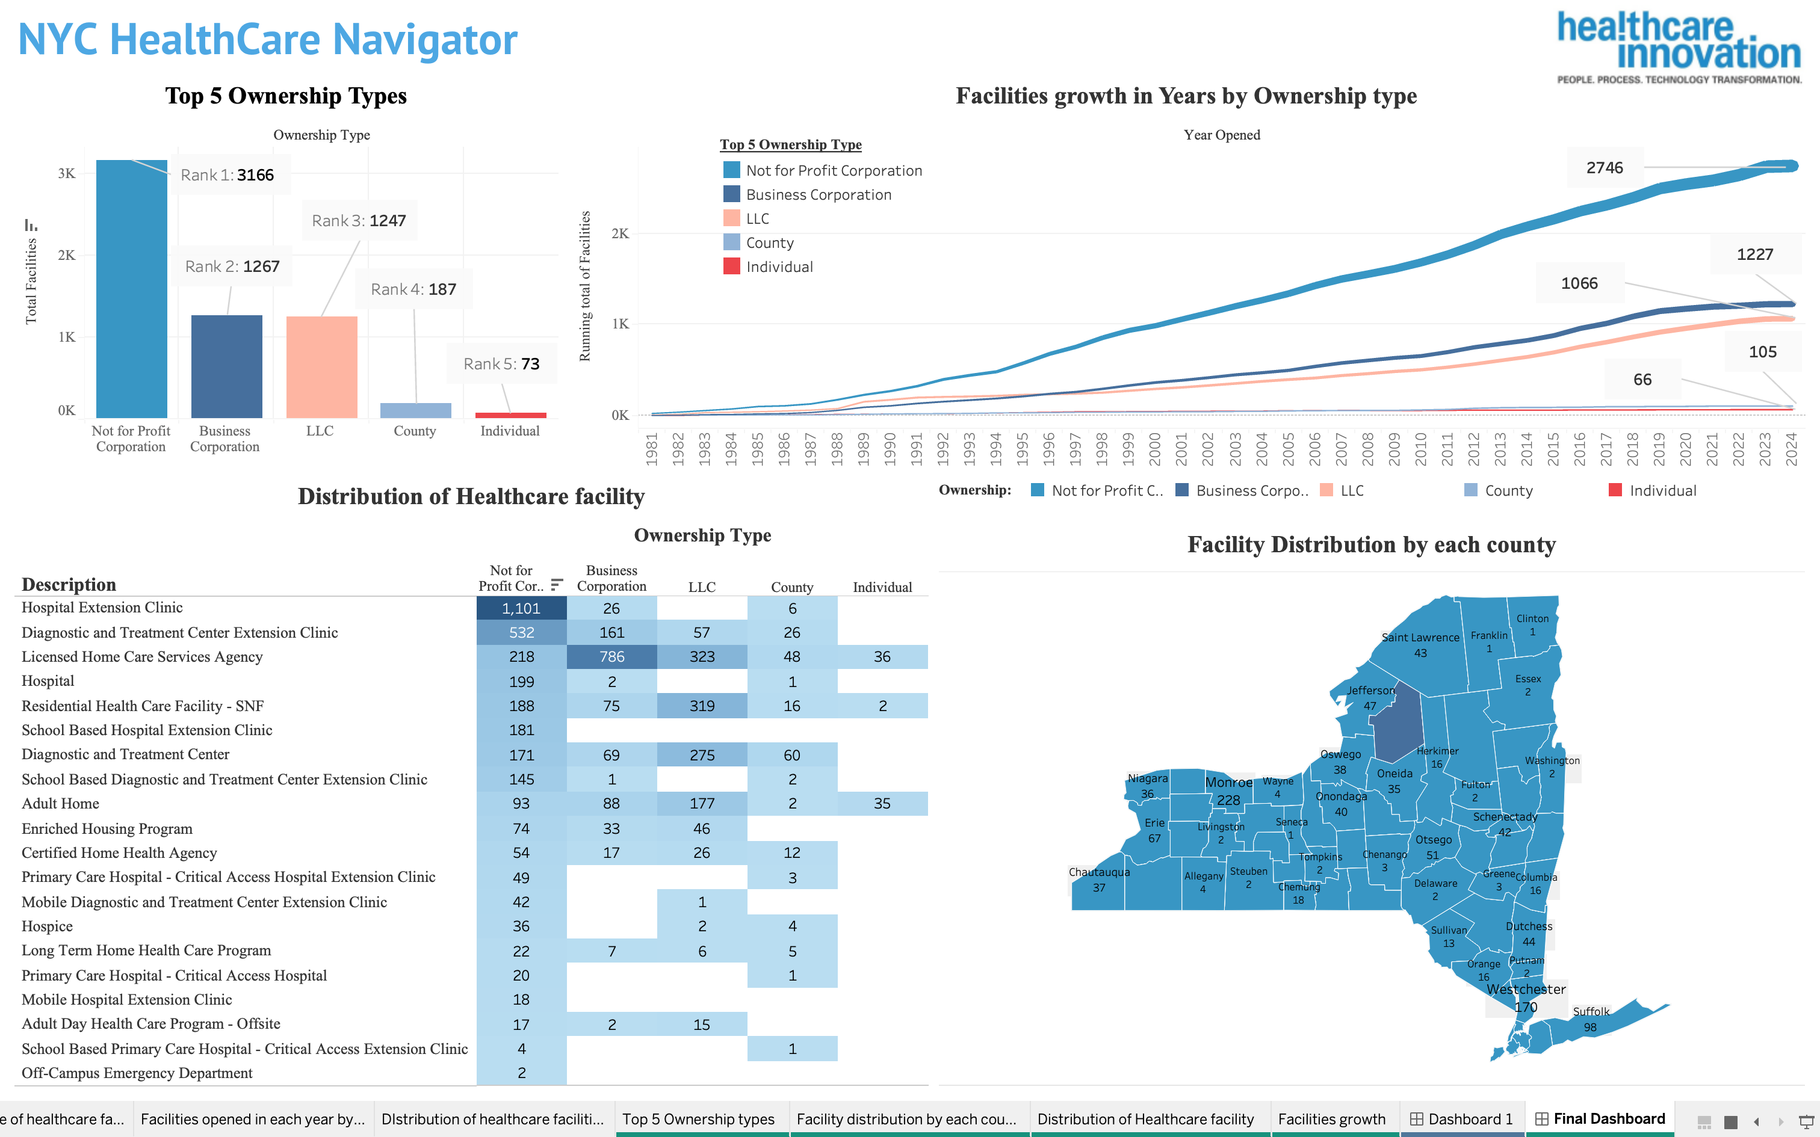

Slide 7

Conclusion
The NYC HealthCare Navigator has transformed healthcare access in New York City. Led by Olivia Mitchell, the Chief Medical Officer at Healthcare Innovation, this dashboard simplifies the city's complex healthcare system, providing a user-friendly map of all healthcare facilities. It allows patients and families to easily find the right services and offers recommendations for the best facilities. Healthcare professionals and policymakers can use the dashboard to identify gaps in healthcare and make data-driven decisions. This innovative solution ensures quality healthcare is accessible to all New Yorkers, guiding Healthcare Innovation's efforts to improve healthcare equity and resource allocation across the city.

Slide 8


